Slide 1
OOP CONCEPTS
Ciosa Alexandru
Pitic Florin
in-tech engineering services SRL

Slide 2
INHERITANCE
Inheritance can be defined as a process where a class acquires properties (objects and behaviors) of another. With the use of inheritance the information is made manageable in a hierarchical order.
The class which inherits the properties of other is known as subclass (derived class, child class) and the class whose properties are inherited is known as superclass (base class, parent class).
Why use inheritance in java?
For Method Overriding (so runtime polymorphism can be achieved).
For Code Reusability.
extends is the keyword used to inherit the properties of a class. Following is the syntax of extends keyword.

Slide 3
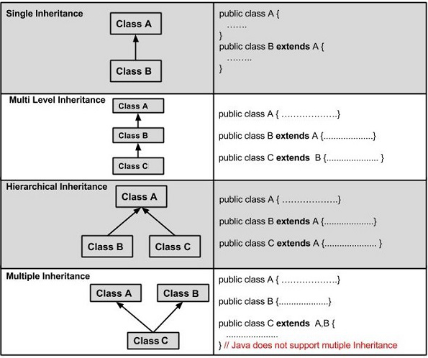
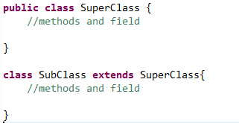
Type of inheritance in Java
Syntax of Java Inheritance

Slide 4
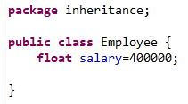
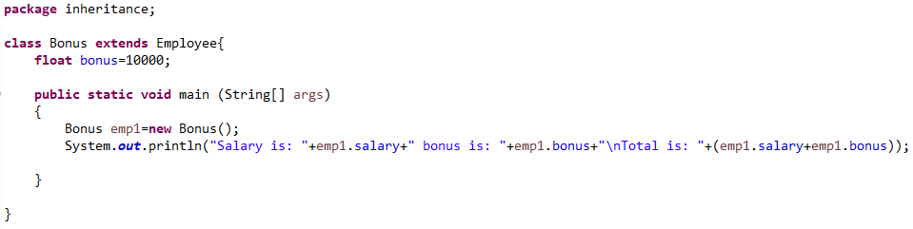

Single inheritance example:
Output

Slide 5
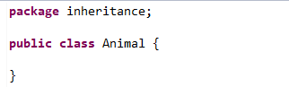
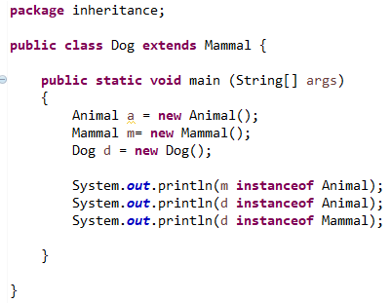

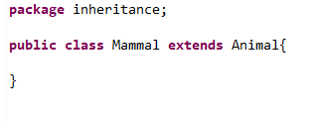
Multilevel Inheritance example:

Slide 6
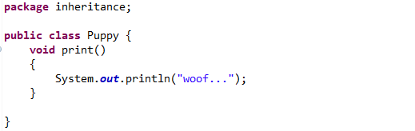
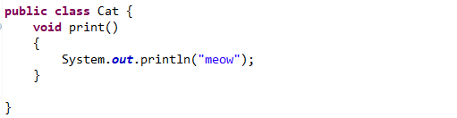
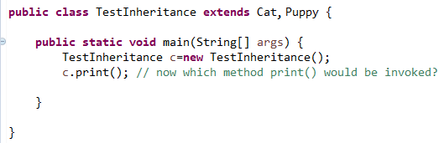
Multiple Inheritance :
Multiple inheritance is not allowed in Java, because when a class inherits two classes in the same time and those two classes has the same method, the compiler doesn't not know which method its called.

Slide 7
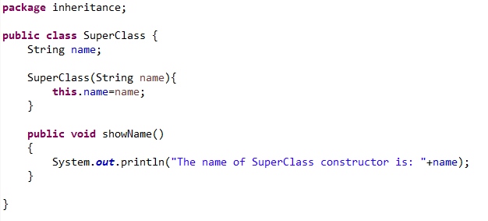
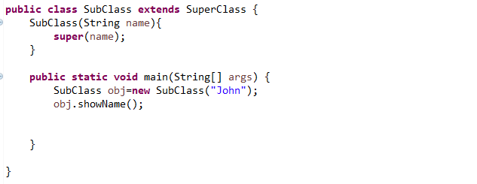

Invoking Superclass Constructor:
If a class is inheriting the properties of another class, the subclass automatically acquires the default constructor of the superclass. But if you want to call a parameterized constructor of the superclass, you need to use the super keyword like super(value)

Slide 8
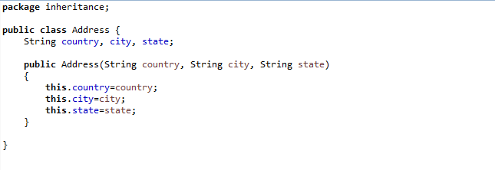
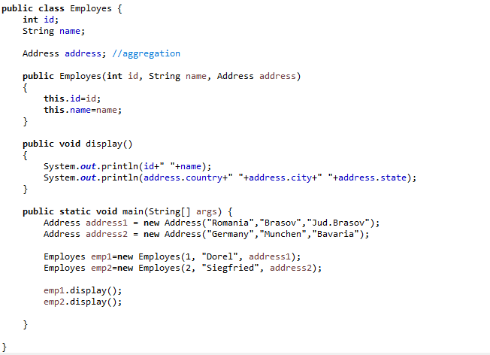
HAS-A relationship:
Example:
These relationships are mainly based on the usage. This determines whether a certain class HAS-A certain thing. This relationship helps to reduce duplication of code as well as bugs.
Consider a situation, Employee object contains many informations such as id, name, email Id etc. It contains one more object named address, which contains its own informations such as city, state, country, zipcode etc.

Slide 9
Polymorphism
Many
Behaviors

Slide 10
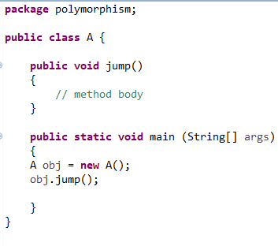
Case 1:
In this first case, the object obj will take the behavior from method jump, because in this class is just one method with this name.

Slide 11
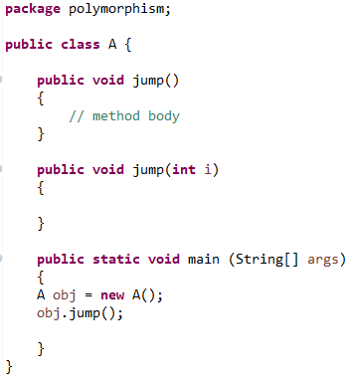
Case 2 example 1:
Now in this case we one class with two methods with the same name. In main function the defined object its taking the behavior from the first method.
Why?
Because we didn’t wrote any parameter into objects method.

Slide 12
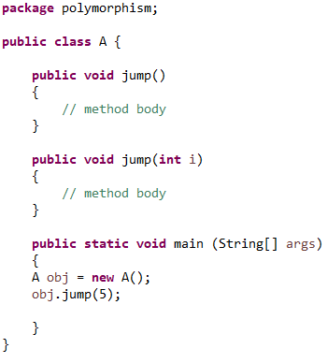
Case 2 example 2:
Same example but now the object will invoke the second method, because an integer parameter have been set.
This is called Method Overloading

Slide 13
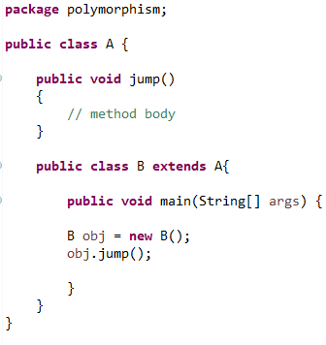
Case 3 example 1:
In this example, the obj object will call the behavior of the method jump, because here is just one method defined in class A, and class B take all from the class A.

Slide 14
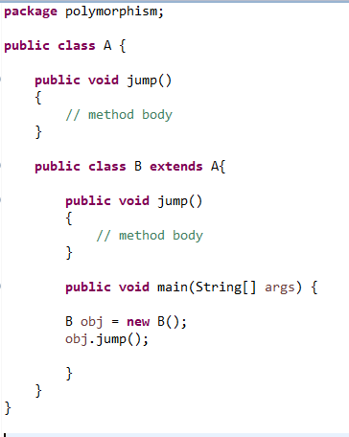
Case 3 example 2:
Here in this example, the obj will take the behavior from the 2nd method jump defined in B class, because now B class has his own jump method.
This is called Method Overriding

Slide 15
Method overloading
Same name, different parameters
Method overriding
Same name, same parameters but different classes

Slide 16
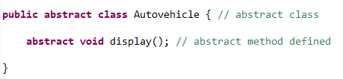
Abstraction
Abstraction is a process of hiding the implementation details from the user, only the functionality will be provided to the user. In other words, the user will have the information on what the object does instead of how it does it.
Defining abstract class and abstract method:

Slide 17
Things to know about abstract classes
1. Abstract classes may or may not contain abstract methods, i.e., methods without body ( public void get(); )
2. But, if a class has at least one abstract method, then the class must be declared abstract.
3. If a class is declared abstract, it cannot be instantiated.
4. To use an abstract class, you have to inherit it from another class, provide implementations to the abstract methods in it.
5. If you inherit an abstract class, you have to provide implementations to all the abstract methods in it.

Slide 18
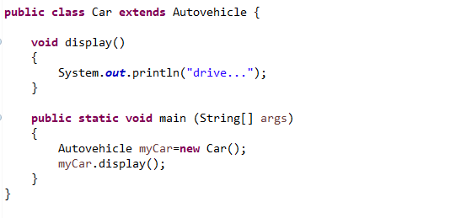
Example:

Slide 19
Composition VS INHERITANCE
Composition over inheritance (or composite reuse principle) in object-oriented programming (OOP) is the principle that classes should achieve polymorphic behavior and code reuse by their composition (by containing instances of other classes that implement the desired functionality) rather than inheritance from a base or parent class.
An implementation of composition over inheritance typically begins with the creation of various interfaces representing the behaviors that the system must exhibit. The use of interfaces allows this technique to support the polymorphic behavior that is so valuable in object-oriented programming. Classes implementing the identified interfaces are built and added to business domain classes as needed. Thus, system behaviors are realized without inheritance.

Slide 20
Composition VS INHERITANCE (EXAMPLE)

Slide 21
ALWAYS REMEMBER THAT...
Multiple inheritance is dangerous if not implemented carefully, as it can lead to
the diamond problem.
The "diamond problem" (sometimes referred to as the "deadly diamond of death") is an ambiguity that arises when two classes B and C inherit from A, and class D inherits from both B and C. If there is a method in A that B and C have overridden, and D does not override it, then which version of the method does D inherit: that of B, or that of C?
Solution:
Java 8 introduces default methods on interfaces. If A,B,C are interfaces, B,C can each provide a different implementation to an abstract method of A, causing the diamond problem. Either class D must reimplement the method (the body of which can simply forward the call to one of the super implementations), or the ambiguity will be rejected as a compile error. Prior to Java 8, Java was not subject to the Diamond problem risk, as Java does not support multiple inheritance.

Slide 22
INTERFACES IN JAVA 8
Java Interface Default Method
Java Interface Static Method
Java Functional Interfaces

Slide 23
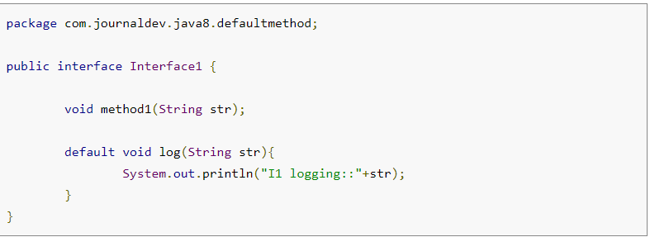
java interface default method
For creating a default method in java interface, we need to use “default” keyword with the method signature.
Notice that log(String str) is the default method in the Interface1. Now when a class will implement Interface1, it is not mandatory to provide implementation for default methods of interface. This feature will help us in extending interfaces with additional methods, all we need is to provide a default implementation.

Slide 24
java interface default method
If a class is implementing two interfaces and doesn’t implement the common default method, compiler can’t decide which one to chose.
Extending multiple interfaces are an integral part of Java, you will find it in the core java classes as well as in most of the enterprise application and frameworks. So to make sure, this problem won’t occur in interfaces, it’s made mandatory to provide implementation for common default methods of interfaces.
(Example:) if a class is implementing two interfaces (with the same log() method), it will have to provide implementation for log() method otherwise compiler will throw a compile time error.

Slide 25
Java Interface Static Method
Java interface static method is similar to default method except that we can’t override them in the implementation classes. This feature helps us in avoiding undesired results incase of poor implementation in implementation classes.
Let's see a comparison!

Slide 26
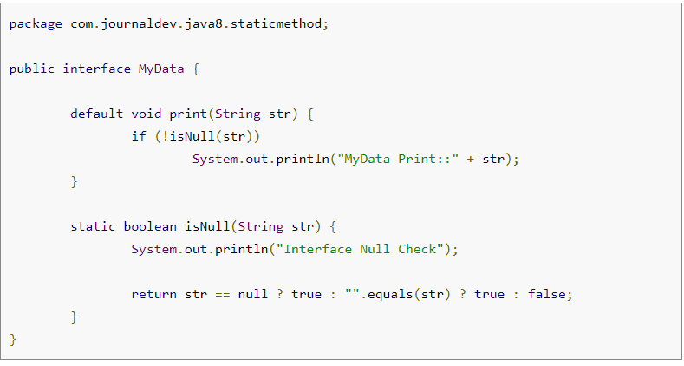
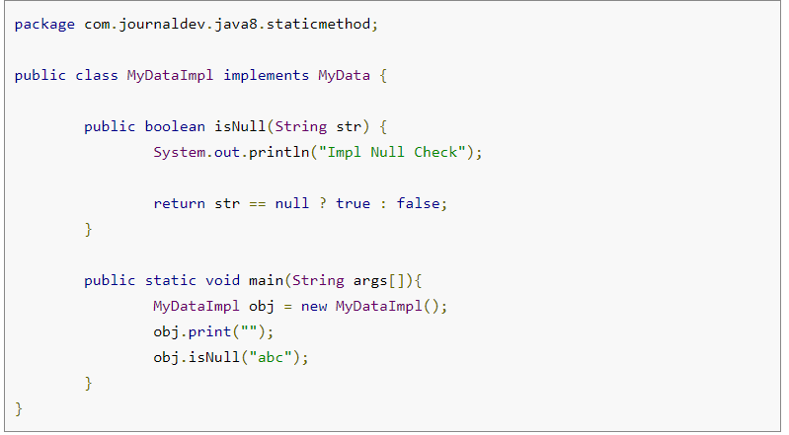
Java Interface Static Method (COMPARISON)
Correct implementation
Incorrect implementation

Slide 27
Java Interface Static Method
Note that isNull(String str) is a simple class method, it’s not overriding the interface method. For example, if we will add @Override annotation to the isNull() method, it will result in compiler error.
Java interface static method is visible to interface methods only, if we remove the isNull() method from the MyDataImpl class, we won’t be able to use it for the MyDataImpl object. However like other static methods, we can use interface static methods using class name.

Slide 28
java functional interfaces
An interface with exactly one abstract method is known as Functional Interface. A new annotation @FunctionalInterface has been introduced to mark an interface as Functional Interface. @FunctionalInterface annotation is a facility to avoid accidental addition of abstract methods in the functional interfaces (it’s optional but good practice to use it.)
Functional interfaces are long awaited and much sought out feature of Java 8 because it enables us to use lambda expressions to instantiate them. A new package java.util.function with bunch of functional interfaces are added to provide target types for lambda expressions and method references.
(An abstract method is a method that is declared, but contains no implementation).

Slide 29
The COLLECTION INTERFACE
A Collection represents a group of objects, known as its elements. The primary use of the Collection interface is to pass around collections of objects where maximum generality is desired.
Suppose, for example, that you have a Collection<String> c, which may be a List, a Set, or another kind of Collection. This idiom creates a new ArrayList (an implementation of the List interface), initially containing all the elements in c. List<String> list = new ArrayList<>(c);
The Collection interface contains methods that perform basic operations, such as: int size(), boolean isEmpty(), boolean contains(Object element), boolean add(E element), boolean remove(Object element), and Iterator<E> iterator().

Slide 30
Cloning (reference)
clone() is a method in the Java programming language for object duplication. In Java, objects are manipulated through reference variables, and there is no operator for copying an object - the assignment operator duplicates the reference, not the object. The clone() method provides this missing functionality.
The syntax for calling clone in Java is (assuming obj is a variable of a class type that has a public clone() method): Object copy = obj.clone(); or commonly MyClass copy = (MyClass) obj.clone();

Slide 31
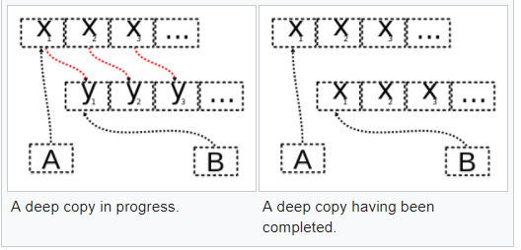
cloning (reference)
The class Object's clone() method creates and returns a copy of the object, with the same class and with all the fields having the same values. However, Object.clone() throws a CloneNotSupportedException unless the object is an instance of a class that implements the marker interface Cloneable.
The default implementation of Object.clone() performs a shallow copy. When a class desires a deep copy or some other custom behavior, they must perform that in their own clone() method after they obtain the copy from the superclass.

Slide 32
CLONING - DRAWBACKS
One disadvantage with the design of the clone() method is that the return type of clone() is Object, and needs to be explicitly cast back into the appropriate type.
Another disadvantage is that one often cannot access the clone() method on an abstract type. Most interfaces and abstract classes in Java do not specify a public clone() method. As a result, often the clone() method can only be used if the actual class of an object is known, which is contrary to the abstraction principle of using the most generic type possible.

Slide 33


